Slide 1
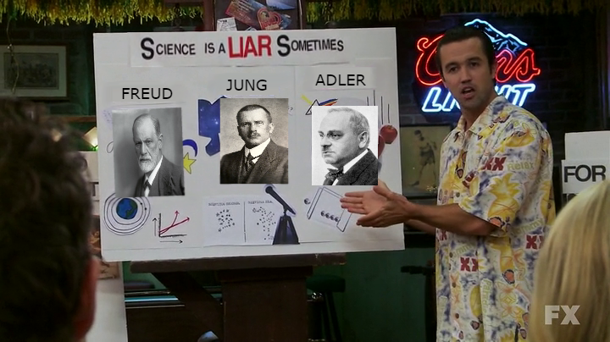
Science is a liar (sometimes): Questionable practices in research and communication

Slide 2
Dr Blake Cavve
Postdoctoral Researcher
Youth Mental Health Team, Telethon Kids Institute
Dr Matthew Andreotta
Postdoctoral Fellow
Environment, CSIRO
Notes:
B + M
Introduce selves
WN land
Both of our backgrounds are in psychology
We'll be talking about examples from psychology and behavioural sciences -- this is where things have been coming to a head over the past few years
however, the principles are applicable to other fields

Slide 3
Telethon Kids Research Integrity Advisors
Notes:
B providing guidance and support in navigating ethical considerations, responsible research practices, and adherence to regulatory requirements
You are welcome to contact any of the RIA’s with queries, guidance, advice regarding research integrity.
Search "Research Integrity Advisors" on telescope

Slide 4
Scenario
You’re a PhD student. You get the opportunity to spend some time overseas in the lab of a famous, well regarded and prolific researcher. This is a good opportunity for you to publish some media friendly research (which is important for your future employment and funding prospects).
This academic gives you a large, detailed dataset from a self-funded, “failed” study which had null results and asks you to work until you find something interesting (and publishable) in this data set.
Would you go?
Assuming you decide to go, how would you approach finding an effect in this data set?
Notes:
B
Id like to start us off with a scenario
Leave time to ask audience for reflections

Slide 5
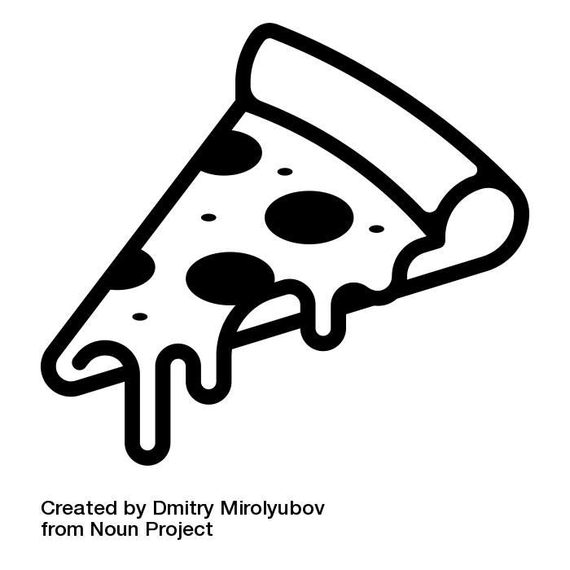
Scenario
PhD student from Turkey (2013)
Brian Wansink (prestigious Cornell Food and Brand Lab)
Expert behavioural economics and nutrition
Environmental effects and “nudges”
Told to “find something interesting” about all-you-can-eat buffets
"This cost us a lot of time and our own money to collect. There's got to be something here we can salvage because it's a cool (rich & unique) data set."
Buzzfeed Report on Wansink’s lab (Lee, 2018) https://goo.gl/trQ62R
Notes:
B There has to be something here not bc of theory/science, but because $$$ spent

Slide 6
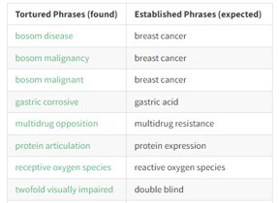
Deliberate malpractice or misconduct
Fabrication of data
Diederik Stapel (Behavioural economics) – 58 retracted studies (New York Times)
Joachim Boldt (Anesthesiology) – 194 retracted studies (retractionwatch leaderboard)
Data tampering
See New York Times piece and Data Colada's report on Dan Ariely (Honesty) and Francesca Gino (Honesty)
Plagiarism
Tortured Phrases (Guillaume Cabanac, Cyril Labbé, Alexander Magazinov; Nick Wise)
Most participant ethics
Dan Ariely – Electric shocks (suspended from MIT)
Lawfare, intimidation, and suppression of publication
D.A.R.E drug abstinence
Francecsa Gino suing Data Colada
Notes:
M - you could do these things but not many people do

Slide 7
Questionable Research Practices (QRPs)
“exploitation of the grey area of acceptable practice.”
Researchers have to make many decisions, that do not have clear unambiguous answers:
Lack clear research question, hypothesis, theory
Important
Novel
Statistically significant
Notes:
M
questionable as opposed to blatantly improper, therefore offer considerable latitude for rationalization and self-deception.
something people may do consciously and deviously but that this is not always the case – researchers have to make many decisions, and due to the pressures they experience the scale is tipped toward interpreting/ making decisions that produce “better” results

Slide 8
QRPs: Study
Failing to report all of a study’s dependent measures
Failing to report all of a study’s conditions
Selectively reporting studies that "worked"
Selective removal/ inclusion of outliers
Notes:
M
Conditions: testing a high, medium and low condition and reporting only the results of a high v medium comparison
Outliers: becomes a QRP when it is used selectively (e.g., removal/ inclusion of outlier is contingent on which produces a sig result)
Say we exclude responses that are “too fast”. Do we exclude the fastest 2.5%, or faster than 2 standard deviations from the mean or from that conditions mean, or faster than 100 or 150 or 200 or 300 ms.
researchers can easily be swayed in ambiguous and defensible positions such as this to fall on the side that best helps their p value.
B
Payne Wansink’s colleague in the food and brand lab seems to just be running every possible combination of variables to see if anything will come up significant.
If you run 400 different tests, youre going to find something just by chance. But if you only report this one test, people wont know.

Slide 9
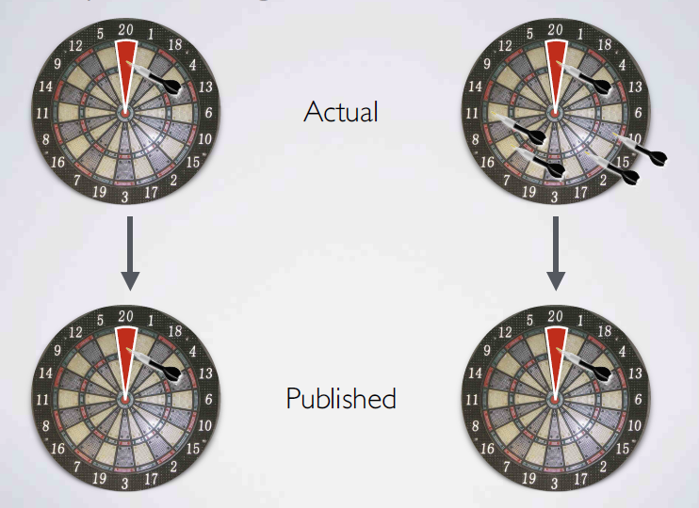
QRPs: Study
P-hacking / B-hacking
Unplanned and undisclosed flexibility in analysis - running multiple analyses until you “find something”.
Schönbrodt https://osf.io/bh7zv/?action=download&version=1
Notes:
M
Undisclosed = misleading to readers + not accounted for statistically
P hacking:
Assuming a null hypothesis significance testing approach
If the p-value is smaller than a certain threshold called alpha level (usually 0.05), then the test result is labelled “significant” and the null hypothesis is rejected.
Researchers who are interested in showing an effect are eager to obtain small p-values so they can reject the null hypothesis and claim the existence of an effect.
Researchers may run more than one test
alpha error accumulation means that more and more hypothesis tests are conducted, the probability of making at least one false decision increases.
the probability is very high that at least one hypothesis test will (erroneously) show a significant result
dropping dependent measures inconsistent w the hypothesis as this enables a more coherent story → publishable
explore various dvs, search for a combination that yields “statistical significance,” and to then report only what “worked.”
SO if we have one dv, data supports hyp
If we have a bunch of dv and only one hyp is supported by our data, then in reality the majority = wrong.
More darts you throw == more likely to hit something by chance.
- reporting- not be telling you about all the darts, concocted a plausible story about why this was the only dart that really mattered (even though I only came up with this story after I threw all the darts).
Acknowledge the context of exploratory research. Issue is w being misrepresented as confirmatory

Slide 10
This is also what Brian Wansink not only advocated, but praised the PhD student working with him for
This is how a null result was turned into 4 (now retracted) papers
Wansink’s infamous blog entry
https://goo.gl/jF9Nki
Buzzfeed Report on Wansink’s lab (Lee, 2018) https://goo.gl/trQ62R
Notes:
B

Slide 11
Wansink’s infamous blog entry
https://goo.gl/jF9Nki
Buzzfeed Report on Wansink’s lab (Lee, 2018) https://goo.gl/trQ62R
Notes:
B

Slide 12
“Males
Females
Lunch goers
People sitting alone
People eating with groups of 2
People eating in groups of 2+
People who order alcohol
People who order soft drinks
People who sit close to buffet
People who sit far away
And so on …”
“# pieces of pizza
# trips
Fill level of plate
Did they get dessert
Did they order a drink
And so on …”
Wansink’s infamous blog entry
https://goo.gl/jF9Nki
Buzzfeed Report on Wansink’s lab (Lee, 2018) https://goo.gl/trQ62R
Notes:
B probs heaps more like him who don’t post about their misconduct bragingly

Slide 13
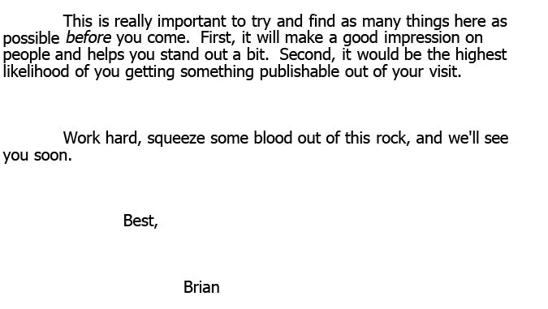
Notes:
B Link this back to pressures discussed earlier
Link back to field rather than specific person
Pause and ask for reflections

Slide 14
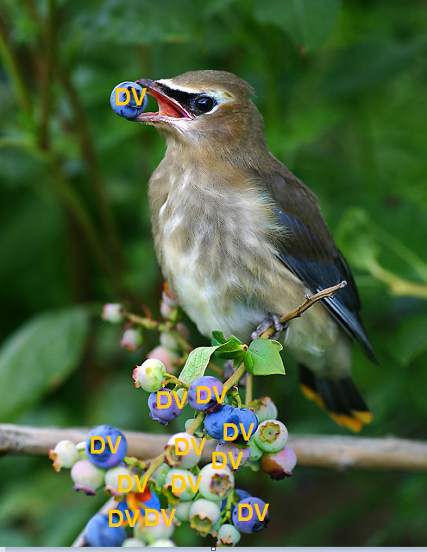
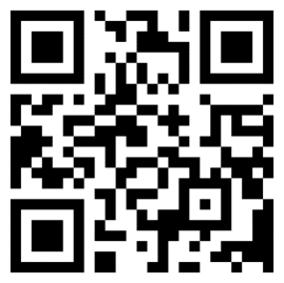
p-hack your way to significance
https://goo.gl/zo518h
Notes:
M Split class in half each w opposing goal 🡪 significance
[Should mark half way through presentation]
[Allow approx 5 - 10 mins]

Slide 15
Estimating QRP prevalence: Study
John et al., (2011) 2000 U.S.-based psychologists Mean Self Admission Rate
Notes:
B Okay so now you’ve seen drastic effects Ask student estimates - hands up - go from 0 to 20 to 40 etc

Slide 16
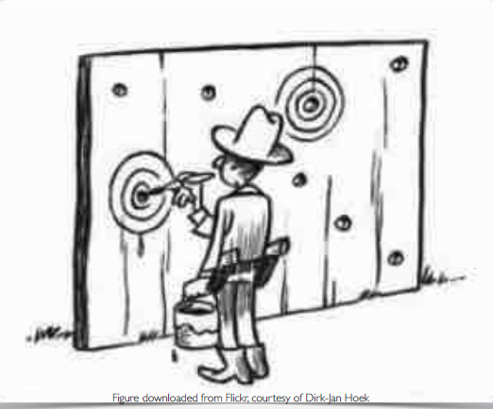
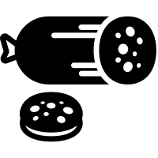
QRPs: Manuscript
Concealing or not publishing selective results
HARKing
Salami slicing
Round of p-values (p = 0.054 to p < 0.05)
Misleading abstracts
Publication process (peer-reviewed?)
Conflict of interest
Notes:
M

Slide 17
Misleading language
Phrase | Median p
"A positive trend" | .07
"A statistical trend" | .08
"A strong trend" | .06
"Almost reached statistical significance" | .06
"Almost significant" | .06
"Approaching significance" | .06
Notes:
M
Examined "Still not significant" phrases used in randomised controlled trials
For each phrase, calculated the median p value associated with the phrase

Slide 18
Estimating QRP prevalence: Manuscript
John et al., (2011) Mean Self Admission Rate
Notes:
B Ask student estimates - p values specifically. Surprisingly high

Slide 19
Estimating QRP prevalence: John et al., (2011)
91% of participants admitted to engaging in at least one QRP
Respondents who admitted to a QRP tended to think that their actions were defensible
but 35% of respondents indicated that they had doubts about the integrity of their own research on at least one occasion.
Notes:
B

Slide 20
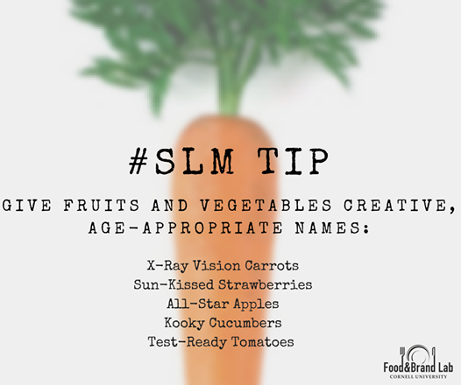
Impact
Food and Brand Lab - Federal grants
National Institute of Health, the US Department of Agriculture, Private Industry, Not for Profits, and Research Foundations.
Smarter lunchrooms movement
Recommendations and interventions are inspired by Wansink’s research
Tens of millions of dollars in state and federal funds
30,000 schools over 7 years
SLM Approach and Interventions
https://goo.gl/FpNSAe
Notes:
B [skip if running out of time]
So if we return to Brian wansink

Slide 21
Impact
"Brian Wansink's discoveries might very well change your life." - O, The Oprah Magazine
Accessible, inspiring message: weight loss is possible via small environmental changes, without need for intense diets
two self-help-style books
200 journal articles
Notes:
B [skip if running out of time]
18 studies have been retracted (one twice) + 15 corrections
Cornell has opened multiple investigations
Still has massive impact on nutrition

Slide 22
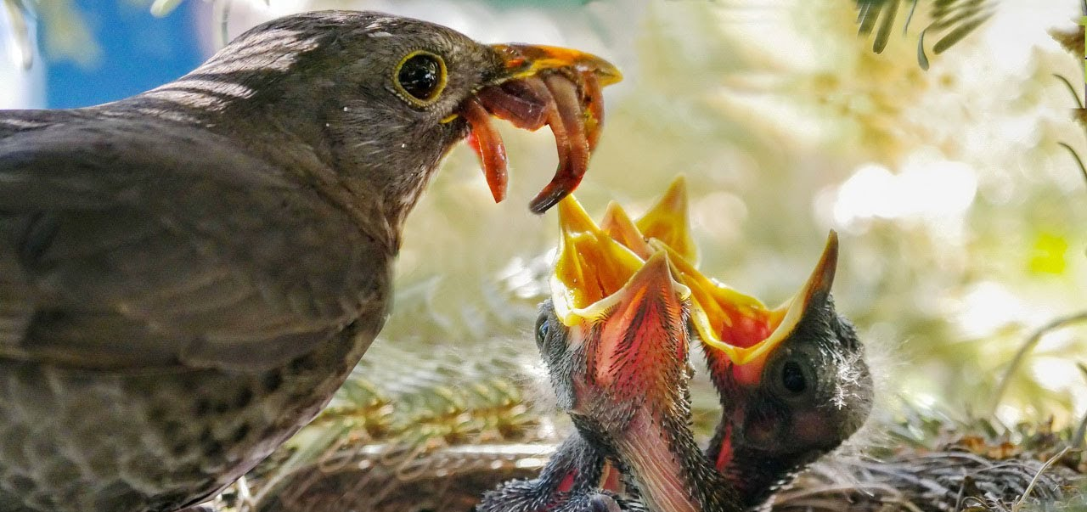
You = a producer and consumer of science As a producer of science
Record keeping and data dictionaries
Processes
Conditions
Crediting contributions
Open Science Framework
Pre-registration of hypotheses and analyses
Sharing code and data
Registered reports
Exploratory research
Write about the literature, not just a single study
Rigorous science
You
Other researchers
Notes:
M

Slide 23
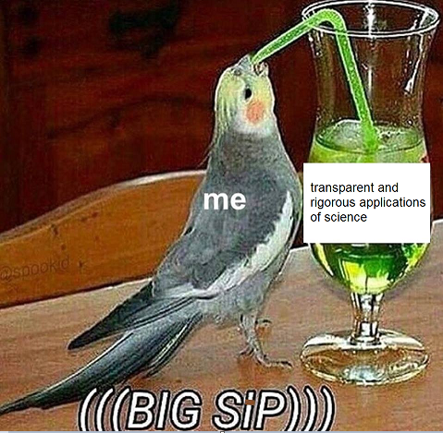
You = a producer and consumer of science As a consumer
Beware of red flags
Study quality
Manuscript quality
Dig deeper to find these
Google researcher names
Check conflicts of interest
Check journals
Reflect. Is it too good to be true?
Notes:
M

Slide 24
Resources
Additional p hacking strategies (Interactive app)
https://shiny.psy.lmu.de/felix/ShinyPHack/
Score and ignore: A radio listener's guide to ignoring health stories https://academic.oup.com/jrssig/article/9/5/45/7029937
How scientists lie https://howscientistslie.com
Elisabeth Bik – image manipulation
Paul Brookes - blog, science-fraud.org, closed due to legal threats in 2013
Adam Marcus and Ivan Oransky - co-founders of Retraction Watch
Guillaume Cabanac, Cyril Labbé, Alexander Magazinov - “tortured phrases” and the Problematic Paper Screener
Nick Wise – pub peer contributor
Nick Brown and James Heathers - Wansink investigation, Sample Parameter Reconstruction via Iterative TEchniques
Brian Nosek - Open Science Framework
Notes:
B

Slide 25
Telethon Kids Research Integrity Advisors
Please stay back or email to request future research integrity topics that interest you. E.g.,:
Pre-registration and registered reports
QRPs in collaboration
QRPs in science journalism (in mice phenomenon)
Publication bias
QRPs in peer review
Fake conferences
Predatory journals, proceedings journals and paper mills
Notes:
B Questionable research practices can be accidental or made under pressured situations and we don’t want to demonize, we want to help
providing guidance and support in navigating ethical considerations, responsible research practices, and adherence to regulatory requirements
You are welcome to contact any of the RIA’s with queries regarding research integrity.
provide you with advice and guidance.
Search "Research Integrity Advisors" on telescope

